Slide 1
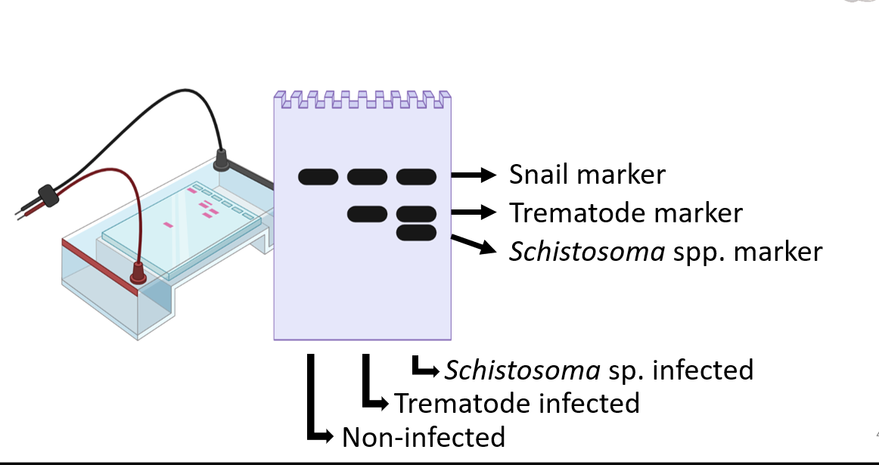
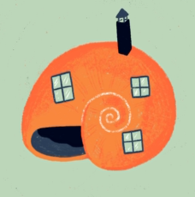
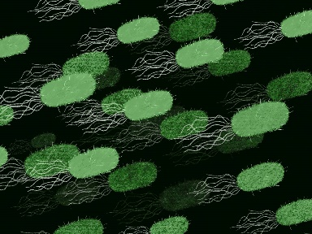
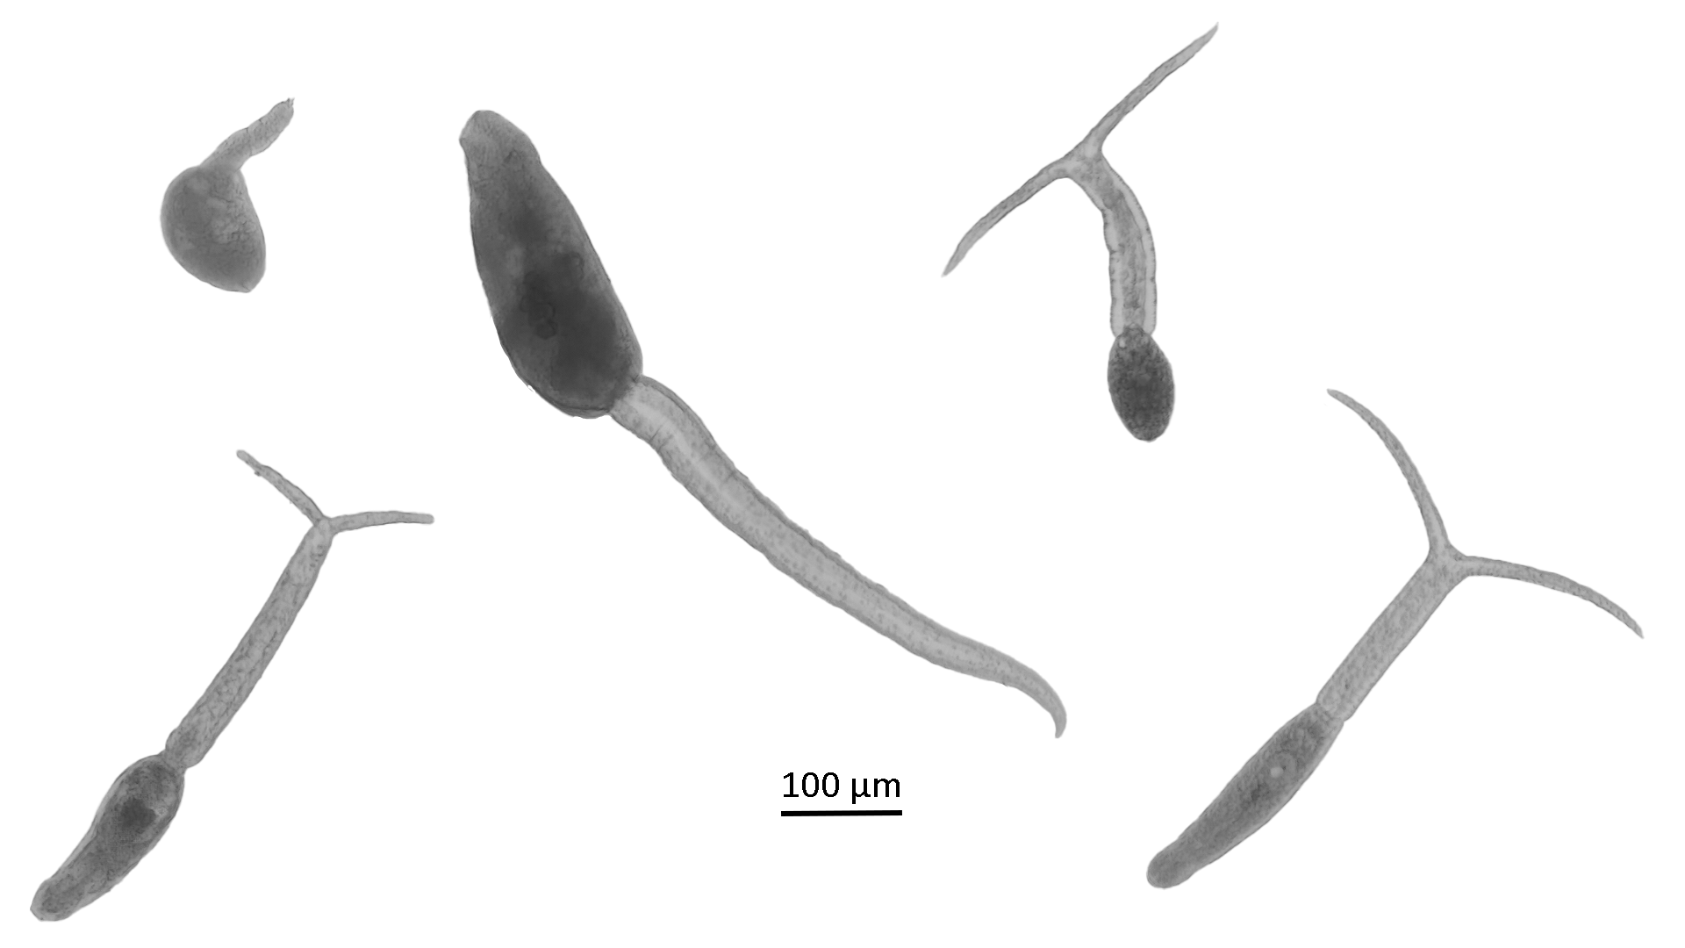
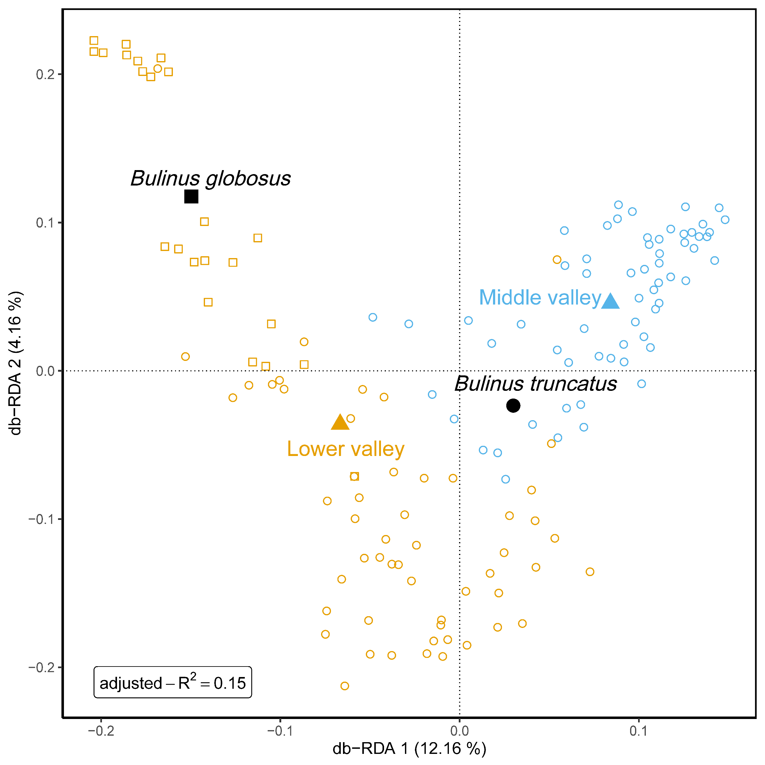
Towards a better understanding of the snail-trematode-microbiome interactions driving schistosome transmission in Senegal Ruben Schols^{1,2}, Cyril Hammoud^{1,3}, Ruben Put², Arthur Piot², Tim Maes², Bruno Senghor⁴, Ellen Decaestecker², Tine Huyse¹
¹The Royal Museum for Central Africa, ²KULeuven-KULAK, ³UGhent, ⁴Cheikh Anta Diop University
Background
In the lower part of the Senegal River Basin (SRB), B. globosus acts as the main snail host for Schistosoma haematobium, whereas B. truncatus does not transmit local S. haematobium strains^{1,2}. In the upper valley and possibly middle valley, however, the situation is reversed^{2,3}.
Aims
To characterize the microbiome and trematode communities of B. truncatus and B. globosus along the SRB and link this to susceptibility towards schistosome infection.
Materials & Methods
Infection diagnostic PCRs⁴
Sanger sequencing
Uninfected
All
16S metabarcoding^{5,6}
Infected
High-Throughput
Amplicon Sequencing⁷
Results
Snails
±2,000 snail specimens.
Eight snail species.
781 B. truncatus & B. globosus.
B. globosus only in lower valley.
Trematodes
138/700 tested snails (20%) released cercariae, of which 66 (48%) Schistosoma spp. and 16 (12%) co-infections.
Five cercarial morphotypes detected (Fig1).
>90% infection prevalence based on diagnostic PCRs.
Fig 1: A) Xiphidiocercaria,
B) Schistosoma sp.,
C) Echinostome,
D) Brevifurcate-apharyngeate distome and
E) longifurcate-pharyngeate distome.
A)
C)
D)
B)
E)
Microbiome
115 B. truncatus & 23 B. globosus.
Snail species and region of origin in the SRB significantly affected alpha and beta diversity (Fig2).
Alpha diversity B. truncatus middle valley < lower valley.
Alpha diversity B. truncatus > B. globosus.
Fig 2: RDA plot showing the microbiome beta diversity of B. truncatus and B. globosus for the lower and middle valley in the SRB.
Conclusion
The HTAS protocol in combination with the microbiome data presented here will determine what drives snail host susceptibility to S. haematobium in the SRB.
Microbiome differs between B. truncatus and B. globosus, and across the SRB.
Transplant experiment to disentangle causation from correlation.
¹Picquet M., J.C. Ernould, J. Vercruysse, V.R. Southgate, A. Mbaye, B. Sambou, M. Niang and D. Rollinson (1996), The epidemiology of human schistosomiasis in the Senegal river basin, Trans. R. Soc. Trop. Med. Hyg., 90, 4, Pages 340–346.; ²Sène M, Southgate VR and Vercruysse J (2004) Bulinus truncatus, intermediate host of Schistosoma haematobium in the Senegal River Basin, Bull. Soc. Pathol. Exot., 97, 29–32.; ³Southgate, V., de Clercq, D., Séne, M., Rollinson, D., LY, A. and Vercruysse, J. (2000). Observations on compatibility between Bulinus truncatus and Schistosoma haematobium in the Senegal river basin. Ann. trop. med. parasitol. 91, 371–378.; ⁴Schols, R., Carolus, H., Hammoud, C., Mulero, S., Mudavanhu, A. and Huyse, T. (2019). A rapid diagnostic multiplex PCR approach for xenomonitoring of human and animal schistosomiasis in a ‘One Health’ context. Trans. R. Soc. Trop. Med. Hyg., 113(11), 722–729.; ⁵Bulteel, L, Houwenhuyse, S, Declerck, S and Decaestecker, E. (2021). The Role of Microbiome and Genotype in Daphnia magna Upon Parasite Re-Exposure. Genes. 12. 70.; ⁶Janssens, L, Van de Maele, M, Delnat, V, Theys, C, Mukherjee, S, De Meester, L and Stoks, R. (2022). Evolution of pesticide tolerance and associated changes in the microbiome in the water flea Daphnia magna. Ecotoxicol. Environ. Saf.. 240. 113697.; ⁷Hammoud, C, Mulero, S, Van Bocxlaer, B, Boissier, J, Verschuren, D, Albrecht, C and Huyse, T. (2021). Simultaneous genotyping of snails and infecting trematode parasites using high‐throughput amplicon sequencing. Mol. Ecol. Resour. 22.
Copyright © 2022 Schols et al.,
ruben.schols@africamuseum.be
MicroResist project:

